Slide 1
English Version
Master Slide Deck

Slide 2
1 | Table of Content
2 | Mission / Vision
3 | Team Introduction
4 | The Problem
5 | The Solution
_{MASTER SLIDEDECK 2025}

Slide 3
We elevate human knowledge with responsible AI.

Slide 4















Who We Are
30+ Employees
35+ Years
We empower professionals to achieve operational excellence and gain a competitive advantage through Al knowledge processes and customised automation solutions.
HQ in Hamburg and Stuttgart
Deep tech & domain founder expertise
20+ Satisfied Customers
Excellence in GenAl Training
competitive advantage through Al
+10.000 Al BlackBelts
Knowledge Protection
Partnerships
through TrustTech Lead Investor
with renowned tech universities
_{MASTER SLIDEDECK 2025}

Slide 5
Key Challenges in Germany’s Economy
Knowledge is the single most impactful competitive advantage companies possess...
Yet, many do not utilize it effectively.
Lack of Experts
Bureaucracy
Employee Turnover
Knowledge Gaps
Cost of Labour
Demographic Change
_{MASTER SLIDEDECK 2025}

Slide 6
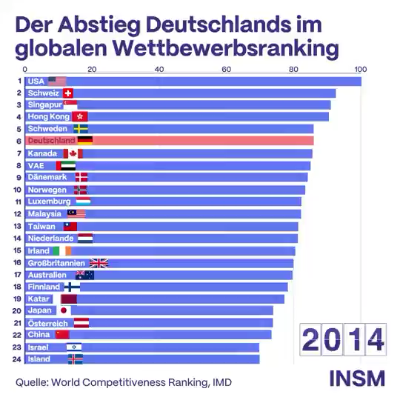
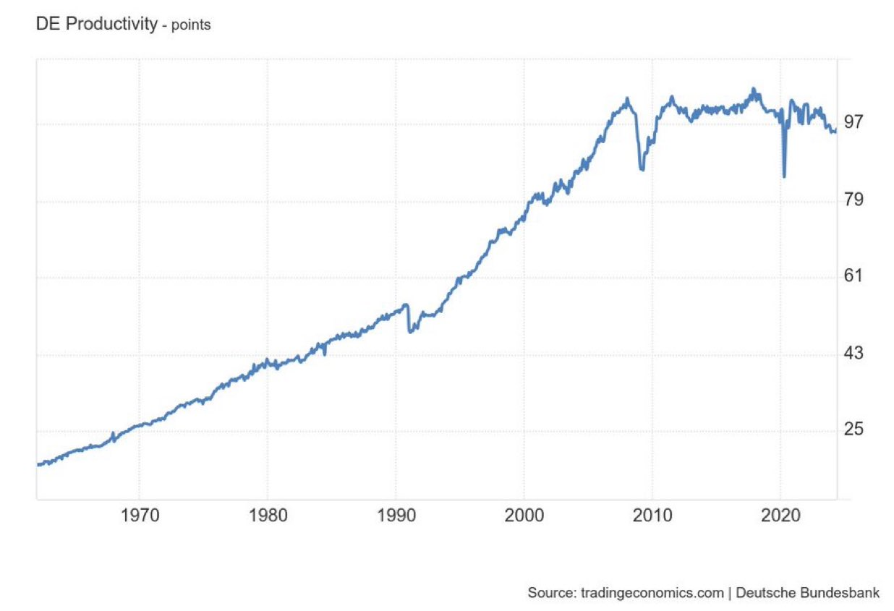
Key challenges in Germany’s economy
Knowledge is the single most impactful competitive advantage companies possess… Yet, many do not utilize it effectively.
_{MASTER SLIDEDECK 2025}

Slide 7

The 10-20-70 Principle for Value Creation
10% Algorithms
20% Technology
Outperforms competitors in enterprise-grade
70% People & processes
Source: BCG AI Radar 2025 Survey
_{MASTER SLIDEDECK 2025}

Slide 8



























Blockbrain’s
Knowledge Bot
Empowering organizations to transform knowledge into unrivaled competitive advantages. Our Knowledge Bots enable companies to have the right knowledge at the right people and place at the right time.
Imagine having your junior & mediocre employees augmented by the combined knowledge of your senior experts.
_{MASTER SLIDEDECK 2025}

Slide 9




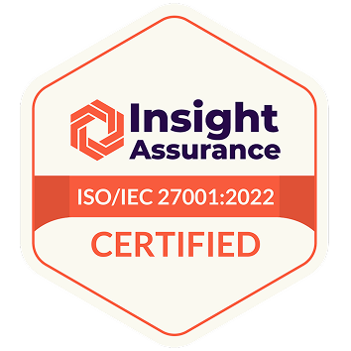


Foundations and Benefits
SECURITY ARCHITECTURE
Infrastructure
Data Isolation
EU-Based Data Centers; Docker Containerization; Secure Authentication
Physical Database Separation; Zero Cross-Client Data Sharing; Custom Tenant Architecture
End-2-end encryption protects all data in transit and rest; client data physically separated in EU Cloud databases.
Zero third-party sharing, no usage for Al training, automatic deletion following legal requirements.
Compliance
Enterprise Validation
ISO 27001 Certified (Zero Non-Conformities); GDPR Compliant
Trusted ov Market Leaders and Cyber Security Experts; G+D Investment
Quality
Complete Transparency
Continuous Monitoring; Accuracy Testing; Performance Checks
Decision Traceability; Human-in-the-Loop Source; Documentation
_{MASTER SLIDEDECK 2025}

Slide 10






What We Do
Process Transformation:
With and without programming knowledge
AI-driven Workflows
Tailored Solutions
Customer Communication
Automation and optimization of repetitive
tasks & business processes
Individual automation solutions that meet your specific requirements
Automated multi-language support responses to routine client inquiries
Integration and Analysis
Empowering Team Members
Process Automation
Knowledge management with internal data, emails, web data, etc.
Enabling every employee to contribute with creative and innovative ideas
Workflow & process automation; seamless API integration
_{MASTER SLIDEDECK 2025}

Slide 11







Legal Knowledge Solutions
BLOCKBRAIN AI SOLUTIONS
AI Document Management
Legal Research & Analysis
Client Communication
Automation and optimization of repetitive tasks & business processes
Automated summary, analysis and real-time monitoring of court decisions
Automated multi-language support responses to routine client inquiries
Knowledge Management
Empowering Team Members
Process Automation
Centralized organisation of legal data; preservation of inhouse expertise
Enabling every employee to contribute with creative and innovative ideas
Workflow & process automation; seamless API integration
_{MASTER SLIDEDECK 2025}

Slide 12





Industrial Knowledge Solutions
BLOCKBRAIN AI SOLUTIONS
Al-driven Workflows
Expert Knowledge Bots
Knowledge Minions
Automation and optimization of repetitive tasks & business processes
Company knowledge into digital twins; preservation of in house expertise
Analysis of internal data, meetings, emails, etc.; automated reports
Specification Creator
Employee Support
Compliance
Automate spec creation with blueprints; finetune in iteration mode
Easy access to company knowledge; faster onboarding; self-service
Efficient document handling; accurate and quick results; source links
_{MASTER SLIDEDECK 2025}

Slide 13


Finance Knowledge Solutions
BLOCKBRAIN AI SOLUTIONS
Al-driven Workflows
Expert Knowledge Bots
Client Communication
Automation and optimization of repetitive tasks & business processes
Company knowledge into digital twins; preservation of in house expertise
Automated multi-language support responses to routine client inquiries
Financial Analysis
Employee Support
Compliance
Automated research, summary, analysis and real-time monitoring of financial data
Easy access to company
knowledge; faster onboarding; self-service
Efficient document handling;
accurate and quick results; source links
_{MASTER SLIDEDECK 2025}

Slide 14




Efficiency Gains in Business Areas
Want to cut through the daily grind?
Unlock faster and more efficient workflows in all corporate domains
Compliance
Industry
Compliance
Compliance
Automatic checking of documents from specialist departments
Answering complex technical questions from employees in seconds.
Automatic structuring and detailed evaluation of dictated sales calls
Automated onboarding and professional support for new employees
10h
2h
50%
90%
Time saved per week
Time saved per day
Efficiency gain
Questions answered
_{MASTER SLIDEDECK 2025}

Slide 15
What Our Customers Say
Our AI solution empowers top-tier companies. It helps them safeguard their valuable knowledge and data.
“Nexus increases my efficiency as a patent attorney on a daily basis and saves thinking time for complex tasks. The fast, precise analysis of large volumes of documents saves time on oppositions and similar tasks without compromising quality. Nexus has the potential to revolutionize the core processes of a patent attorney.”
“Blockbrain offers an AI solution that structures and analyzes internal knowledge, ensuring it’s always accessible and actionable. What sets them apart is the unique combination of large language models (LLMs) with proprietary technology for data security and quality. After testing many solutions, none matched Blockbrain’s level of performance – especially with regards to delivering rapid integration.”
”The Blockbrain Knowledge Bot enables our employees to find relevant information faster. Our teams complete tasks more efficiently and precisely. With Blockbrain’s support, we are integrating generative AI into our processes and setting new standards in the logistics sector to strengthen our competitiveness.”
Dr. Nikolaus Buchheim
Dr. Michael Tagscherer
Timo Nowak
Patent Attorney and Partner
CTO
Head of IT
_{MASTER SLIDEDECK 2025}

Slide 16
Our Journey with Bardehle Pagenberg
March 2024
July 2024
Afterwards
Until Now (March 2025)
First Get-Together
Official Project Start
Initial introduction and kickoff
Informal alignment on collaboration potential
Execution & Iteration
Adoption & Growth
Official start of project Workshops with Founders
Requirements analysis and definition of objectives
Strategy planning
Definition of specific use cases
Clarification of technical requirements
Implementation of power user feedback
Fine-tuning and optimisation
Data clearly indicates that Bardehle became an absolute power user
Users are expanding their knowledge and are utilising more than X tokens per week
Blockbrain becomes Bardehles strategic Al partner
Product Development Cooperation
_{MASTER SLIDEDECK 2025}

Slide 17
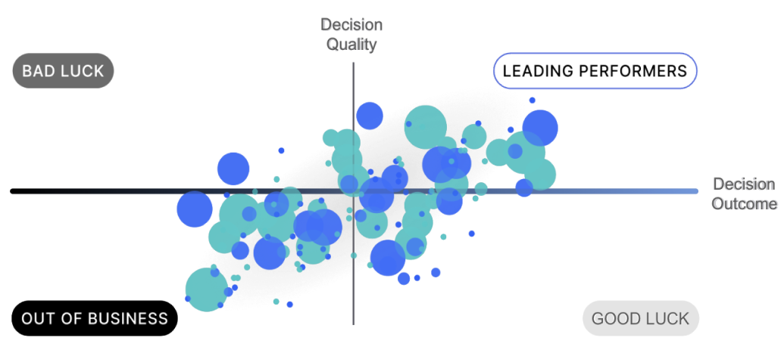
Making the Right Decision
Making the right business decision focuses on quality, not just outcomes. Good decisions can lead to poor results due to chance. Consistent decision-making, not luck, separates top performers from those who fail.
Well-made
Poorly-made
Wrong Decision
Right Decision
_{MASTER SLIDEDECK 2025}

Slide 18
Why Blockbrain Wins
Outperforms competitors in enterprise-grade
AI tool evaluation by Giesecke+Devrient
Tool Evaluation Summary
Number of Tools Tested: 6
Evaluation Criteria: 21 criteria/questions, each with up to 5 points (Maximum: 105 points).
92
POINTS
Results
Top Performer: Blockbrain - 92/105 points.
Other Solutions: Next best scores were 58/105 and 56/105 points (-30%).
Highlights
Blockbrain stood out with exceptional answer quality with no hallucinations, their explainable Al, image processing & delivering the correct graphics at the right time, as well as their knowledge protection approach.
58
POINTS
56
POINTS
Competitor #1
Competitor #2
Blockbrain
_{MASTER SLIDEDECK 2025}

Slide 19
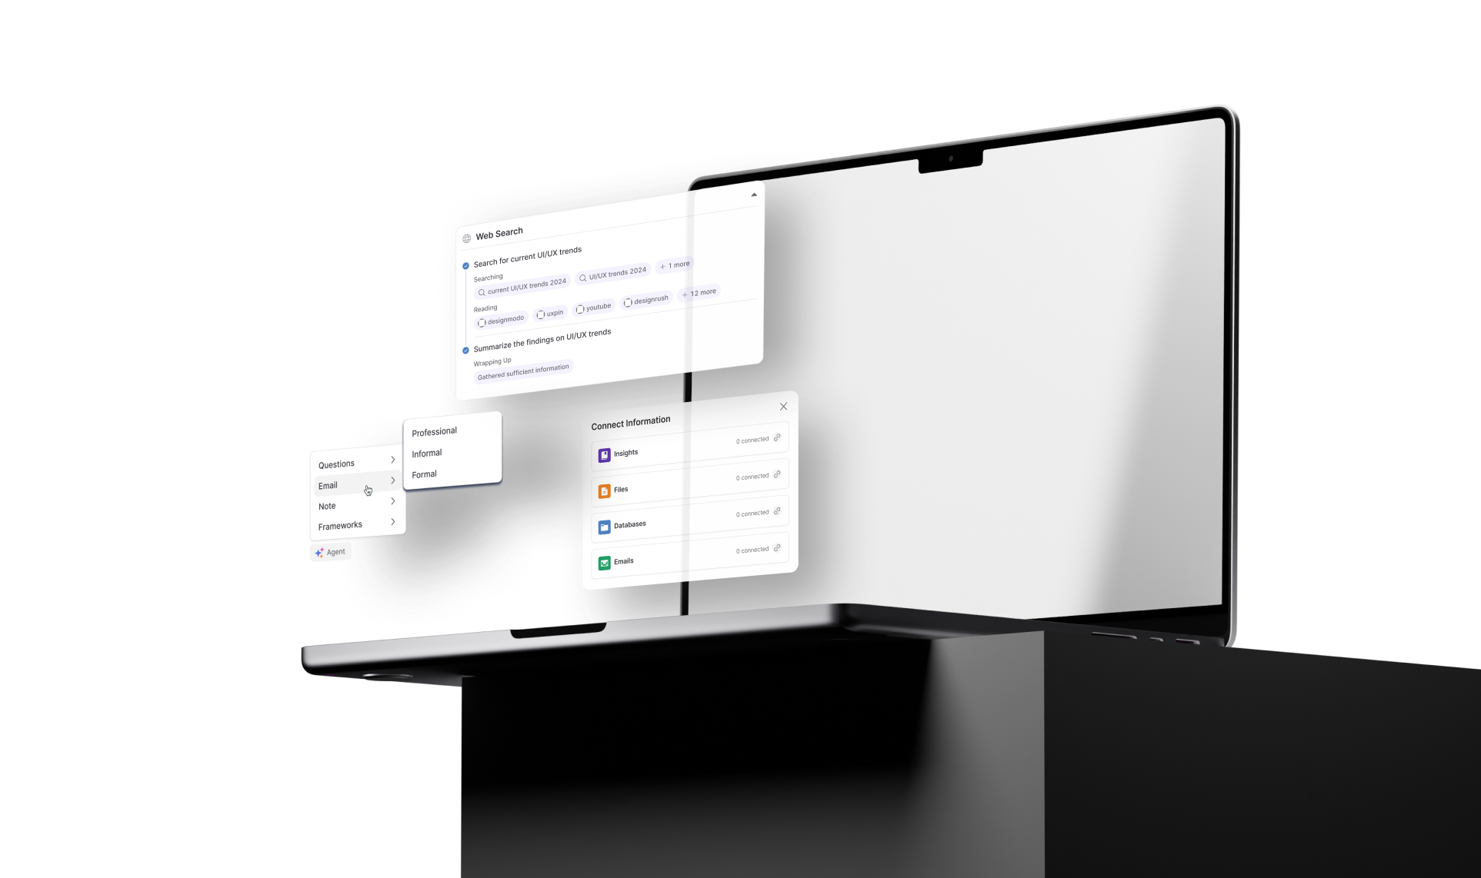
Product Demo
_{MASTER SLIDEDECK 2025}

Slide 20

Preserving Personal Knowledge
Building the bridge from human expert knowledge to Blockbrain's digital twins
Particularly Successful Events
Thought Processes & Decision Factors
Reactions and Reasons
NEXUS
Critical Incidents
Uncovering Critical Intrinsic Knowledge
Retrospective Evaluation & Potential Future Action
_{MASTER SLIDEDECK 2025}

Slide 21


Preserving Personal Knowledge
Building the bridge from human expert knowledge to Blockbrain's digital twins
Identifying the Experts
Subject matter experts
Experienced employees
Customers
Conduct interviews
Focus on critical incidents and success stories
Capture decision-making processes
Document best practices and lessons learned
Integrate Knowledge
Transfer extracted knowledge into the digital twin bot
Implement natural language processing to structure information
Create knowledge graphs to represent relationships and concepts
_{MASTER SLIDEDECK 2025}

Slide 22










Selection of Our Partners
_{MASTER SLIDEDECK 2025}

Slide 23




Blockbrain’s
Knowledge Bot
"Our Knowledge Bots enable companies to have the right knowledge at the right people and place at the right time. Imagine having your junior & mediocre employees augmented by the combined knowledge of your senior experts."
Antonius Gress
Co-Founder of Blockbrain
_{MASTER SLIDEDECK 2025}

Slide 24


































Who We Are
Mattias is the Co-Founder of Statista. He has built and sold four data-driven tech companies and developed software firms generating over €250 million in annual revenue (2022).
Experienced founder team with decades of relevant tech and domain expertise.
Mattias Protzmann
Our Partners
Product, AI, and Strategy
Investors, customers, universities & government
Antonius has led tech teams of over 250 software engineers and has 12+ years of experience in Al, IT, Knowledge Graphs, and RPA bots. He has also successfully built two corporate ventures and own startups.
Antonius Gress
Technology and Execution
_{MASTER SLIDEDECK 2025}

Slide 25


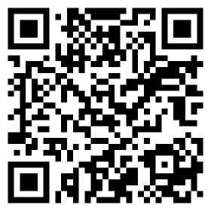
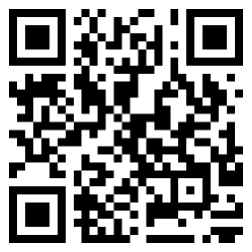
Contact Us
LinkedIn
Website
Interested in learning more?
Happy to hear from you!
linkedin.com/antoniusgress
www.theblockbrain.ai

